Slide 1
Agile and Requirement Engineering in Agile
Week 3
Dr. Natash Ali Mian

Slide 2

Agile Umbrella
Agile
Scrum
Kanban
XP
Scaling frameworks
Crystal methods
FDD
AgileUP
DSDM
Scrumban
Notes:
Agile is an umbrella term and cover a variety of methods.

Slide 3


Fitting Agile Everywhere
Agile methodology not suitable
High certainty projects
Services project
Fixed price projects
Agile methodology suitable
Low certainty projects
There is starting point but no
predetermined scope
Allow discovery for future evolution
New startups

Slide 4
Project life cycles
Four types of life cycles
Predictive life cycle
Iterative life cycle
Incremental life cycle
Agile life cycle

Slide 5
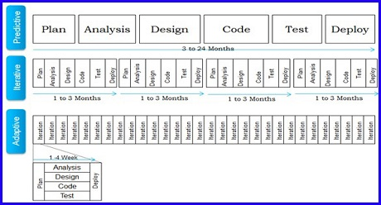
Predictive life cycle/Plan driven/waterfall
A more traditional approach, with the bulk of planning occurring upfront, then executing in a single pass; sequential process
Take advantage of known and proven things.
Reduced uncertainty and complexity
Allow team to segment work into a sequence of predictable grouping

Slide 6
Iterative life cycle
Allows feedback for unfinished work to improve and modify that work.
Projects take advantage of iterative life cycle when complexity is high
Used when changes are frequent.
May take longer because optimized for learning rather then delivery

Slide 7
Incremental life cycle
Frequent delivery of smaller deliverables is called an incremental life cycle
An approach that provides finished deliverables that the customer may be able to use immediately.
Customers are willing to take subset of overall solution
Projects optimized for speed of delivery
Businesses that couldn’t wait for every thing to be completed

Slide 8
Agile life cycle/Change driven/Adaptive
An approach that is
both iterative and incremental to refine work items ,
deliver frequently and
get feedback to better plan the next part of the project.
Customer satisfaction increases with early and continues delivery of valuable product.
In iteration based agile teams works in iteration(time boxes of equal duration) to deliver completed features.

Slide 9
Characteristics of project life cycles
Life Cycle | Requirements | Activities | Delivery | Goal
Predictive | Fixed | Each activity performed one time for entire project | Single delivery | Manage goal and cost
Iterative | Changing | Activities repeated until things get correct | Single delivery | Correctness of solution
Incremental | Changing | Each activity performed one time for a given increment | Frequent smaller deliveries | Frequency/speed
Agile | Changing | Activities repeated until things get correct | Frequent smaller deliveries | Customer value via frequent deliverables and their feedback

Slide 10
Hybrid life cycle
A combination of predictive, iterative, incremental and/or agile approaches is a hybrid approach.
The point is to select a life cycle or a combination of life cycles that work for the project, the risk/team and the culture.
Doing agile technique should not be the goal but to achieve project goals so Its not necessary to use single approach for entire project.
For example, a detailed requirements effort, followed by sprints of incremental delivery would be a “Hybrid Approach”.

Slide 11
High
Incremental
Agile
Hybrid
Frequency of delivery
Predictive
Iterative
Low
Low
Degree of change
High

Slide 12
Agile manifesto
Manifesto for Agile Software Development
We are uncovering better ways of developing software by doing it and helping others do it. Through this work we have come to value:
Individuals and interactions over processes and tools Working software over comprehensive documentation Customer collaboration over contract negotiation Responding to change over following a plan
That is, while there is value in the items on the right, we value the items on the left more.

Slide 13
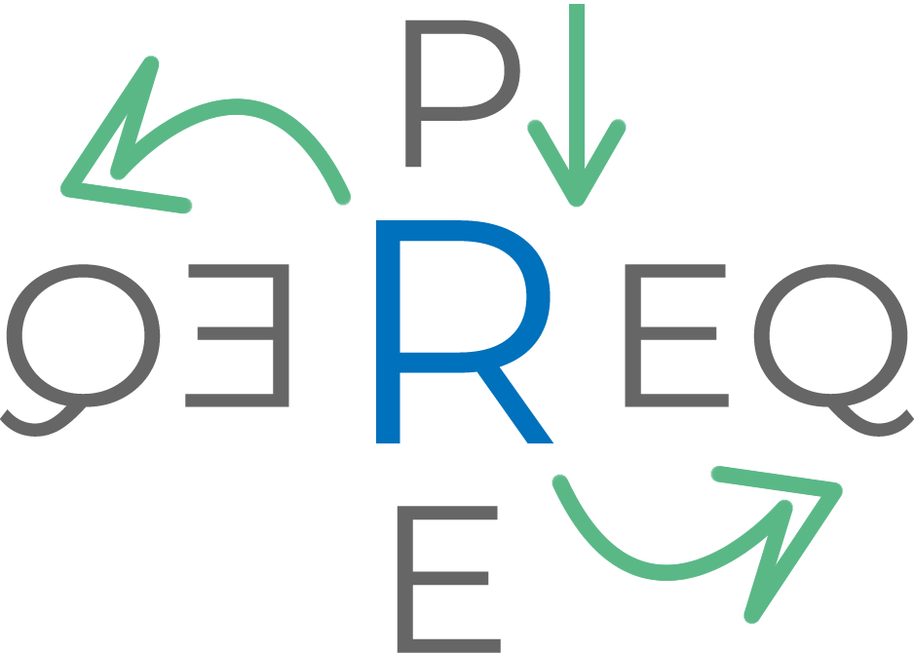



What we hope to Achieve
We will try to shed some light on requirement engineering issues that would help you in getting the right requirements and be able to track them properly.
Notes:
Introduction of the Speaker
Objective of the Talk – What do you need to have before taking requirements, What are the skills mainly involved, how to capture the most. How do you take requirements when in Agile. How do you manage your backlog.

Slide 14



Before We Start!
A Stitch in Time Saves Nine!
Notes:
Group Activity – Chinese Whisper – Objective is to bring into practice what happens when the understanding level is not the same.

Slide 15
Traditional Requirements
Criteria to which system or business should adhere
Generated before coding begins
Often considered as constraints, conditions or capabilities of system
Rarely contain acceptance criteria
Contract between business and development

Slide 16
User Story
A product feature description written by Customer/Proxy from the perspective of end user.
It helps team understand what work is to be done
Customer/Proxy prioritizes and team estimates them
It usually follows the format:
As a : <Role>
I want to : <Function>
So that : <Desired Goal>

Slide 17
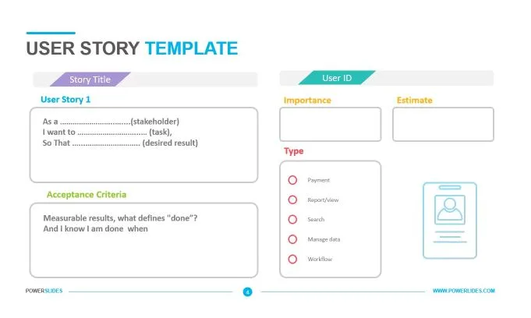

Slide 18
User Story (contd.)
Shifts focus from writing about requirements to talking about them
Not a highly detailed document, rather a reminder for further collaboration
A User Story should be End to End

Slide 19
INVEST
Independent | Reduced dependencies, easy planning
Negotiable | Details are added via collaboration
Valuable | Provides value to customer
Estimable | Should not be big / vague
Small | Can be done in less than a week by team
Testable | Has acceptance criteria

Slide 20
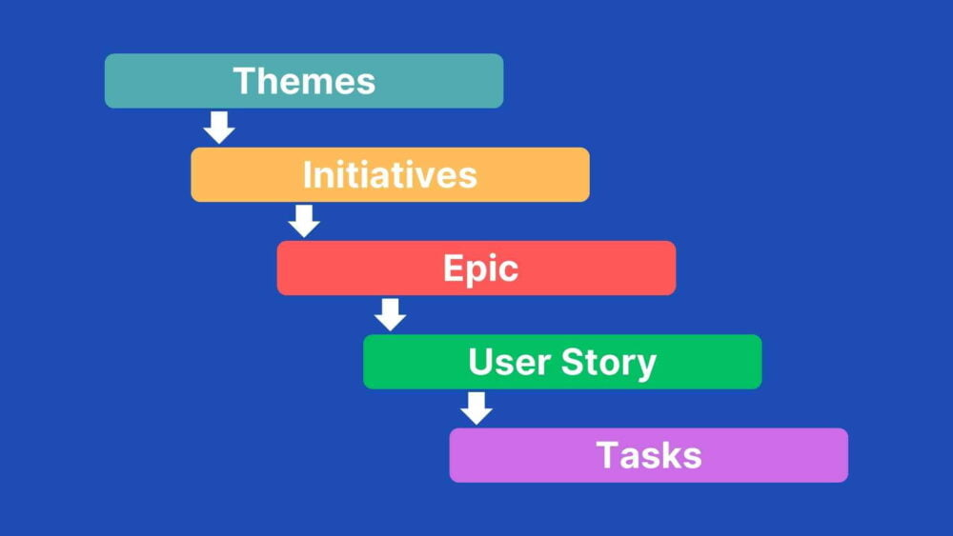

Slide 21
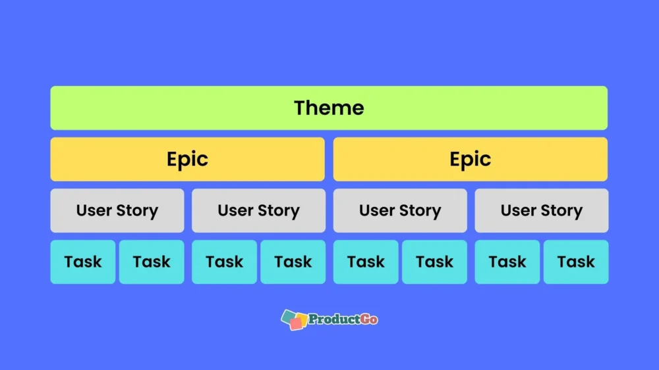

Slide 22
Epic and Theme
Epic is a large story that can be further divided into multiple stories
Theme is a collection of related stories
For example, “A user can search for job” can be split into multiple stories:
Search by Location, Salary Range, etc.
View Job Detail
View Company Profile
Improve Student Experience -> Develop Student Portal-> View grades

Slide 23
Recap Agile Manifesto
Individuals and interactions over processes and tools
Working software over comprehensive documentation
Customer collaboration over contract negotiation
Responding to change over following a plan
That is, while there is value in the items on the right, we value the items on the left more.
Notes:
Recapping the Agile manifesto will give a strong base in spreading awareness in regards to how important communication skills are and will give reference to the group activity of the same.

Slide 24
Requirement Sources
Although there is usually one main source but there are different types of that sources
Project Owner with Domain and Technical Knowledge
Project Owner with only Domain Knowledge
Project Owner with only Technical Knowledge
Project Owner – just because…
Notes:
With DK and TK – Dictated, not much room to question requirements
With DK – Collaborative and relies on Solution from Team
With TK – Usually concerned with technical aspect more and solution is single dimensional.
By Title – Usually concerned with the Deadlines.

Slide 25
Requirement Sources
Regardless of the source the main issue always come depending on Location.
Local / Desi
English Speaking
Non-English Speaking (Who try very hard to speak English)

Slide 26
The Most Common Issue
What was required is not what was developed!

Slide 27
WHY?!!!
Objective/Envisioned Product/Project was not clear
Requirements were not captured properly
Requirements understanding was different
Requirements were not QUESTIONED! Only questions about the requirements were asked.

Slide 28
Solution 1/4
As we usually face communication hurdles we need to make sure that we Document the requirements given. This will ensure that all parties are on the same page
BUT THE MANIFESTO SAID Customer collaboration over contract negotiation
Or Working software over comprehensive documentation
Notes:
True – but in our part of the world we need to make sure that requirements are documented and verified as that can save a lot of time and face with the project owner/client.

Slide 29
Solution 2/4
Question the Requirements for deeper understanding of the Domain. Contribute in the Solution as it will help in covering scenarios that the project owner might have missed.
Notes:
Jo Aagya - Andyo

Slide 30
Solution 3/4
Don’t just jump into it. Lincoln Said “Give me six hours to chop down a tree and I will spend the first four sharpening the axe.” Plan.
Notes:
Discuss and Plan with development team.

Slide 31
Solution 4/4
THINKING THAT AGILE IS ABOUT STICKING TO THE MANIFESTO AND THERE IS NO ROOM FOR INOVATION, ADAPTABILITY OR CHANGE.
Notes:
Discuss and Plan with development team.

Slide 32
SUMMARY FOR REQUIREMENT GATHERING
We need to Document the requirement to ensure an intended product is built. How you document depends on What suits you and your Project.
Communication Skills is very important. Just Speaking the Language does not qualify that Communication is being done. It is a multidirectional skill

Slide 33
SUMMARY FOR REQUIREMENT GATHERING (Cont.)
Be a part of the Requirements. Question the Requirements and the about the requirements.
Agile is a mind set and is meant to be fluid. Mold it to what your project needs and what the environment is and not the other way around.

Slide 34
The Obvious answer is wrong

